Slide 1
XSLT Knowledge
Name Referent
Title/ Function
Corporate Customer & Enterprise Integration
Date

Slide 2
XSLT Knowledge
XML-Basic knowledge
XSLT-Basic knowledge
XSLT Use in SWORD
Examples

Slide 3
XML-Basic knowledge
What is XML
XPath-Expression
Axis-model
Predicates
Functions

Slide 4
What is XML
Motivation
XML (EXtensible Markup Language) is a markup language similar to HTML, but without predefined tags to use.
XML declaration
<?xml version="1.0" encoding="UTF-8"?>
Attributes:
version:
Used version XML in this document.
encoding :
Used encoding in this document.

Slide 5
XPath-Expression
An Expression has:
axis- model
node-test
Predicates (optional)

Slide 6
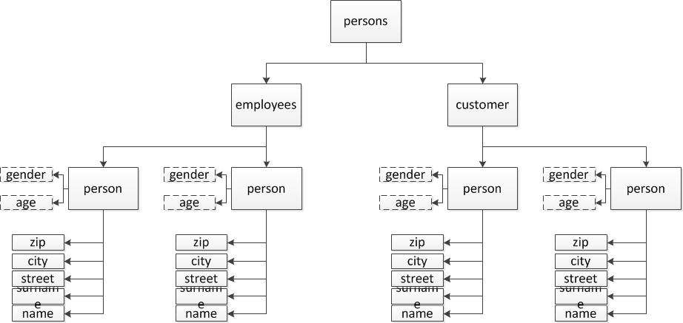
Axis-model

Slide 7
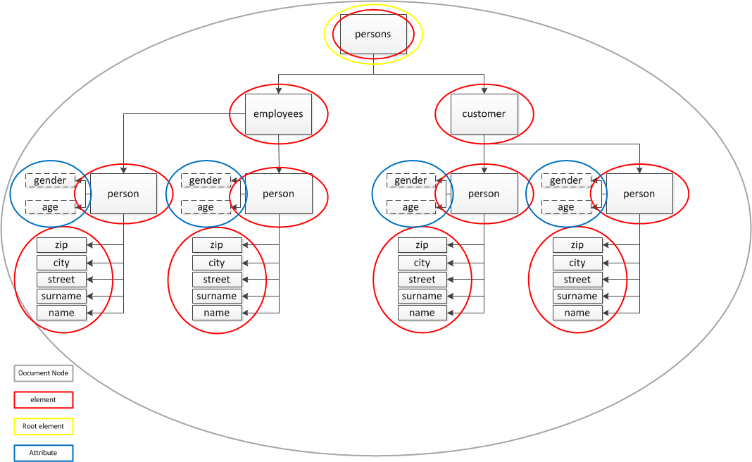
Axis-model

Slide 8
Axis-model
Achse | adressierte Knoten | Beispiel | Abkürzung
child | direct child nodes | /persons/employees/person[1]/child::* | *
parent | direct parent node | /persons/employees/person[1]/parent::* | ..
self | the node itselft | /persons/employees/person[1]/self::* | .
ancestor | All parent nodes up to the root | /persons/employees/person[1]/ancestor::*[1]
ancestor-or-self | Same as ancestor but the node itself too | /persons/employees/person[1]/ancestor-or-self::*[1]
descendant | All child nodes follwoing, not only the direct childs | /persons/employees/person[1]/descendant::* | .//
descendant-or-self | Same as descendant but the node itself too | /persons/employees/person[1]/descendant-or-self::*

Slide 9
Axis-model
achse | adressierte Knoten | Beispiel | Abkürzung
following | All nodes which are following in the whole document | /persons/employees/person[1]/following::*
following-sibling | All nodes which are following in the whole document but on the same level | /persons/employees/person[1]/following-sibling::*
preceding | All nodes which are preceding in the whole document | /persons/customers/person[1]/preceding::*
preceding-sibling | All nodes which are preceding in the whole document but on the same level | /persons/customers/person[2]/preceding-sibling::*
attribute | Attributknoten | /persons/customers/person[2]/attribute::* | @

Slide 10
Node-test
XPath defines several node tests that can be used to select nodes from the source tree.
Strictly speaking, any XPath expression can be considered a node test.
e.g.
/persons/customers/……
/persons/customers/list
/persons/customers/person
/persons/customers/node()
/persons/customers/text()
/persons/customers/comment()
/persons/customers/processing-instruction()

Slide 11
Node-test
Two types of node-test
1)customized
2)Common use
a. Text(): Selects all the text-node children of the context node.
b. Node():Is true for all nodes, regardless of type. Using this node test selects all element nodes, attribute nodes
c. processing-instruction nodes, etc.
d. comment():Selects all the comment-node children of the context node.
processing-instruction()

Slide 12
Predicates
Predicates:
Predicate refers to the XPath expression written in square brackets. It refers to restrict the selected nodes in a node set for some condition.
S.No. | Predicate & Description
1 | /persons/customer/person[1] Select first person element which is child of the customer element.
2 | /persons/customer/person[last()] Select last person element which is child of the customer element.
3 | /persons/customer/person[@gender = ‘male’] Select person element with gender is Male.
4 | /persons/customer/person[age>25] Select person element with age > 25.

Slide 13
Predicates
Special predicates:
position()
last()
not()

Slide 14
Predicates
Logical operations:
Syntax: <Expression> and|or <Expression [Expression][Expression]
If(/..) then.. else ..
Example: find all male persons or persons with surname
A) Find node: //person => returns all person (employees and customer!)
B) define condition:
➔ //person[surname=“Sack”]
➔ //person[@gender=“male”]
C) add operation:
➔//person[surname=“Sack” or @gender=“male”]
Example 2: find all male persons which are older than 30 years:
➔ //person[surname=“Sack”][age > 30]

Slide 15
Functions
Important functions:
substring()
substring-before(source, splitter)
substring-after(source, splitter)
string-length()
count()
concat()
name()
max() (Xpath 2.0!)
min() (Xpath 2.0!)
upper-case (Xpath 2.0!)
lower-case (Xpath 2.0!)
format-number(number,format,[decimalformat]) (Xpath 3.0!)

Slide 16
Functions
Important functions:
Normalize-space()
Translate()
tokenize()
https://www.w3school.com.cn/xpath/xpath_functions.asp

